Slide 1
Design III Final Presentation
Kayla Gorrell
Trevor Dawideit
Jonathan Joshua
Darren George

Slide 2
Objective

Slide 3
Objective
Learn how to solve problems dealing with stress, strain, etc.
Use a variety of analytical tools to help us interpret this information
What a truss is and how it’s used
To build a brass truss to withstand a specific loading while abiding by several requirements
To expand on the topics we covered in Mechanics of Solids class

Slide 4
Requirements

Slide 5
Requirements
4” height limit
15” length
No more than 2” below the base of the truss
325 lbs minimum load
500 lbs maximum load
Cannot use more than 72” of tubing

Slide 6
Design

Slide 7
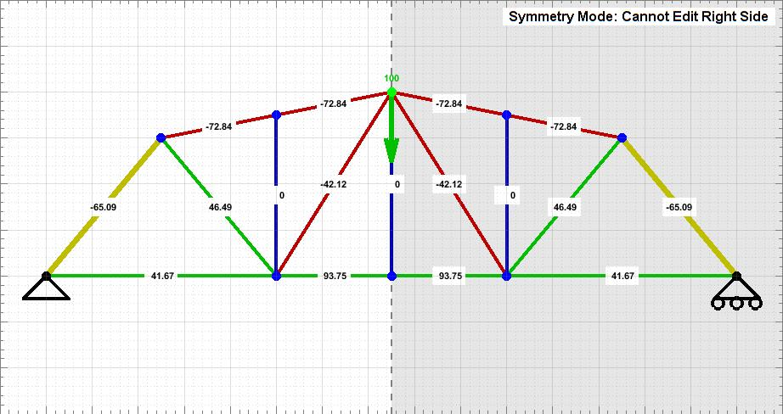
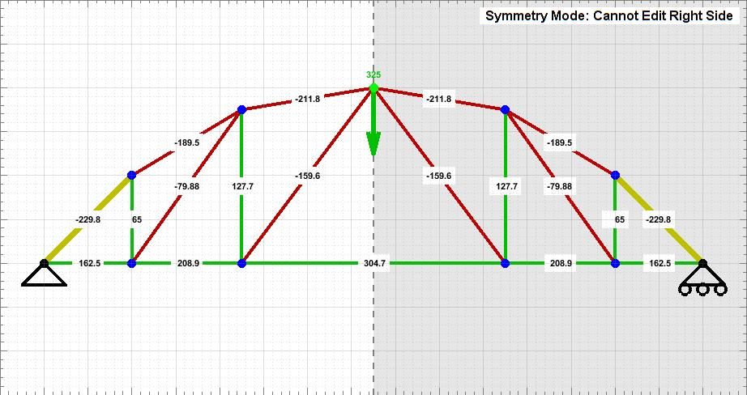
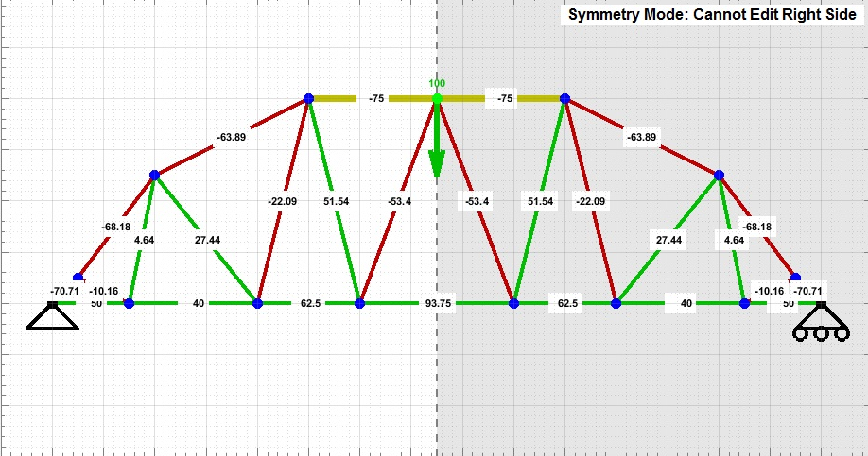
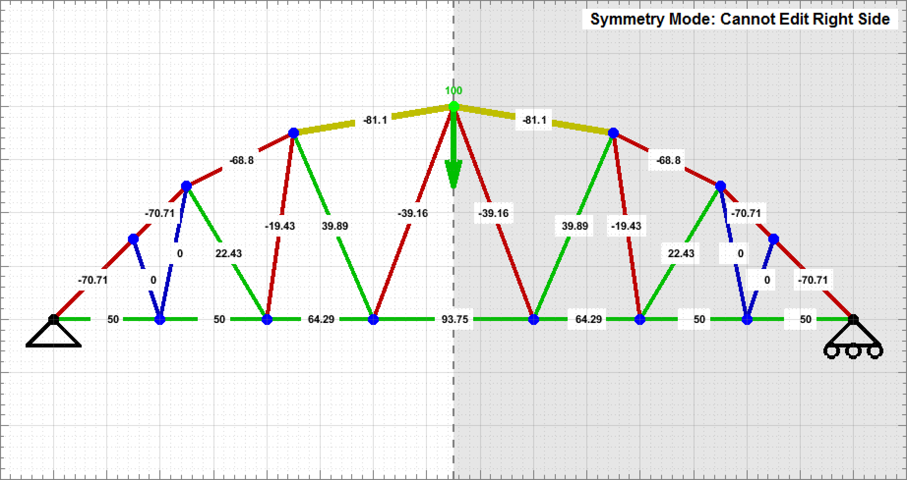
Choosing a Design
Max Load: 327.8 lbs, Length: 61.25, Strength/Length Ratio: 5.35
Max Load: 355 lbs, Length: 62.17, Strength/Length Ratio: 5.71
Max Load: 350.0 lbs, Length: 79.1, Strength/Length Ratio: 4.42
Max Load: 300.3 lbs, Length:69.95, Strength/Length Ratio: 4.29
Notes:
Kayla
Trevor
Darren
Jonathan

Slide 8
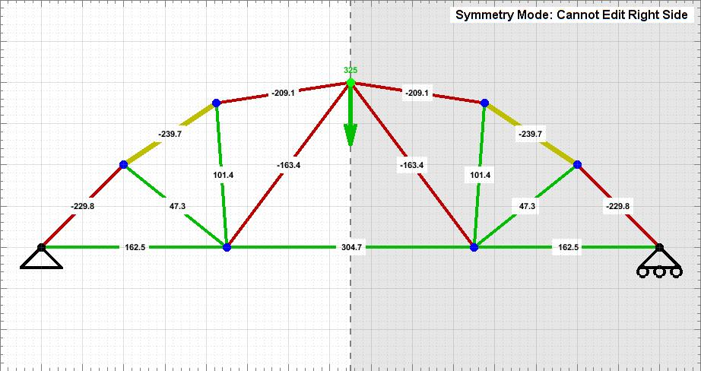
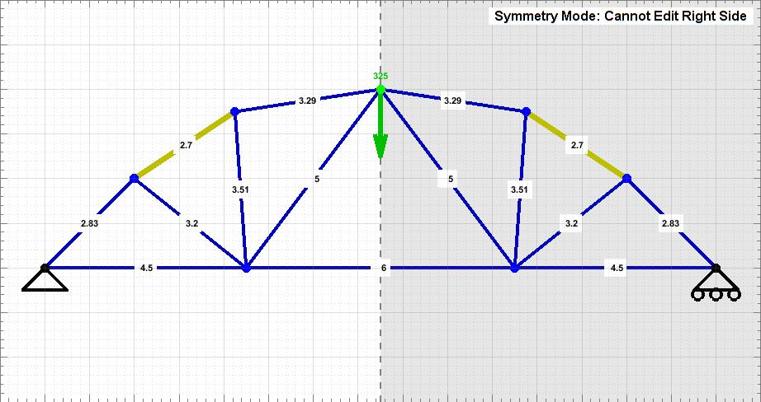
Final Design
Maximum Load:346.2 lbs
Total Length:56.06 in
Strength to Length Ratio:6.18

Slide 9
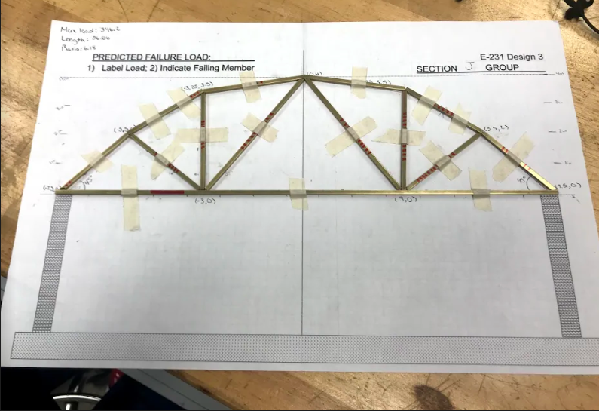
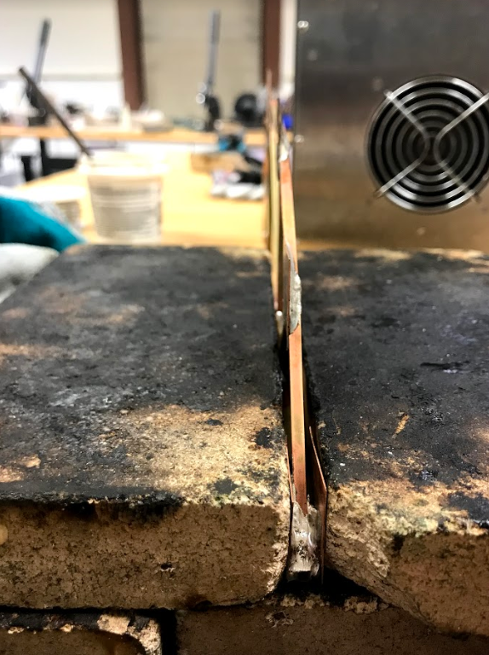
Fabrication Obstacles
Length Miscalculations
Double Gussets

Slide 10
Testing

Slide 11
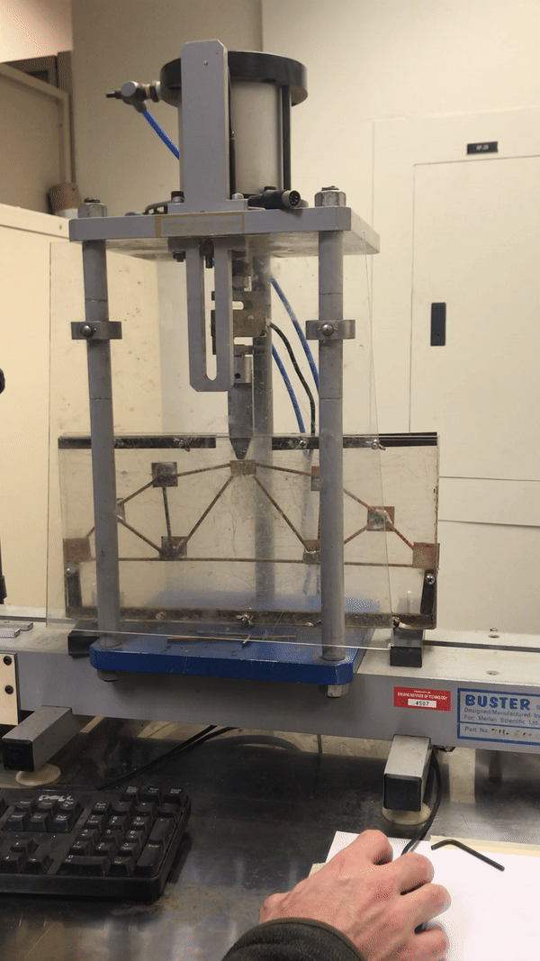
Actual Load Held: 300.2lbs
13.29% less than designed

Slide 12
Final Evaluation

Slide 13
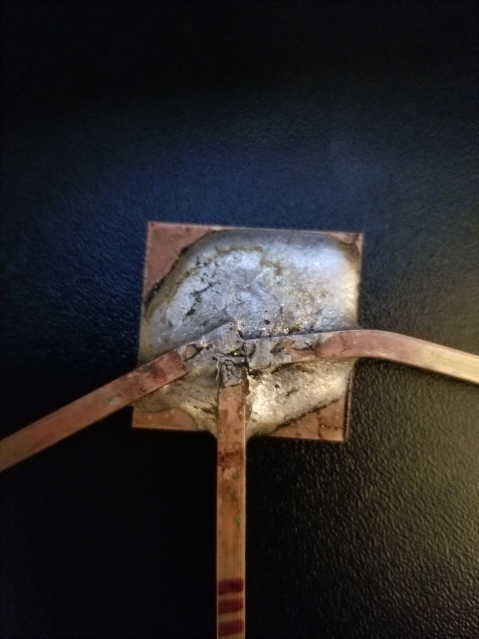
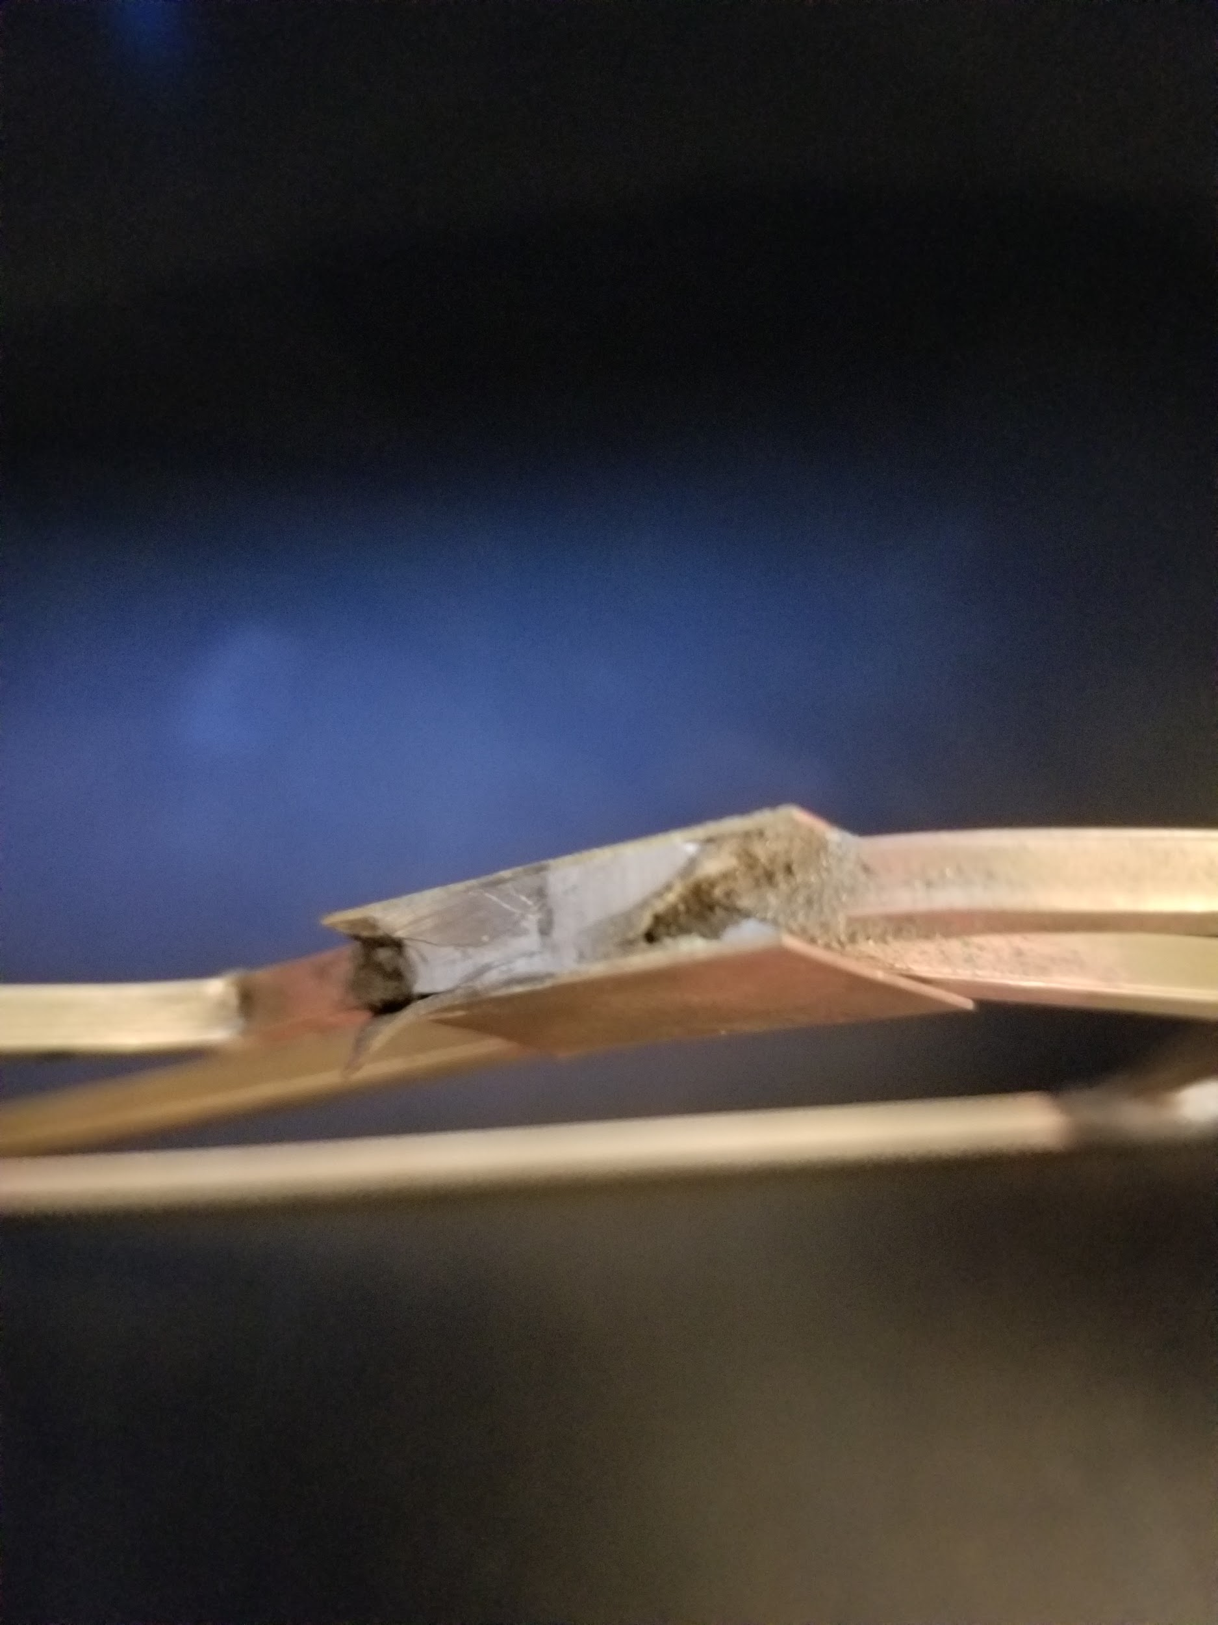
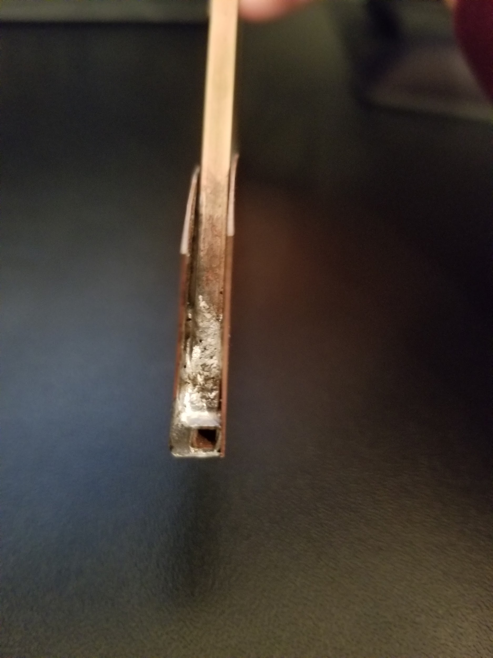
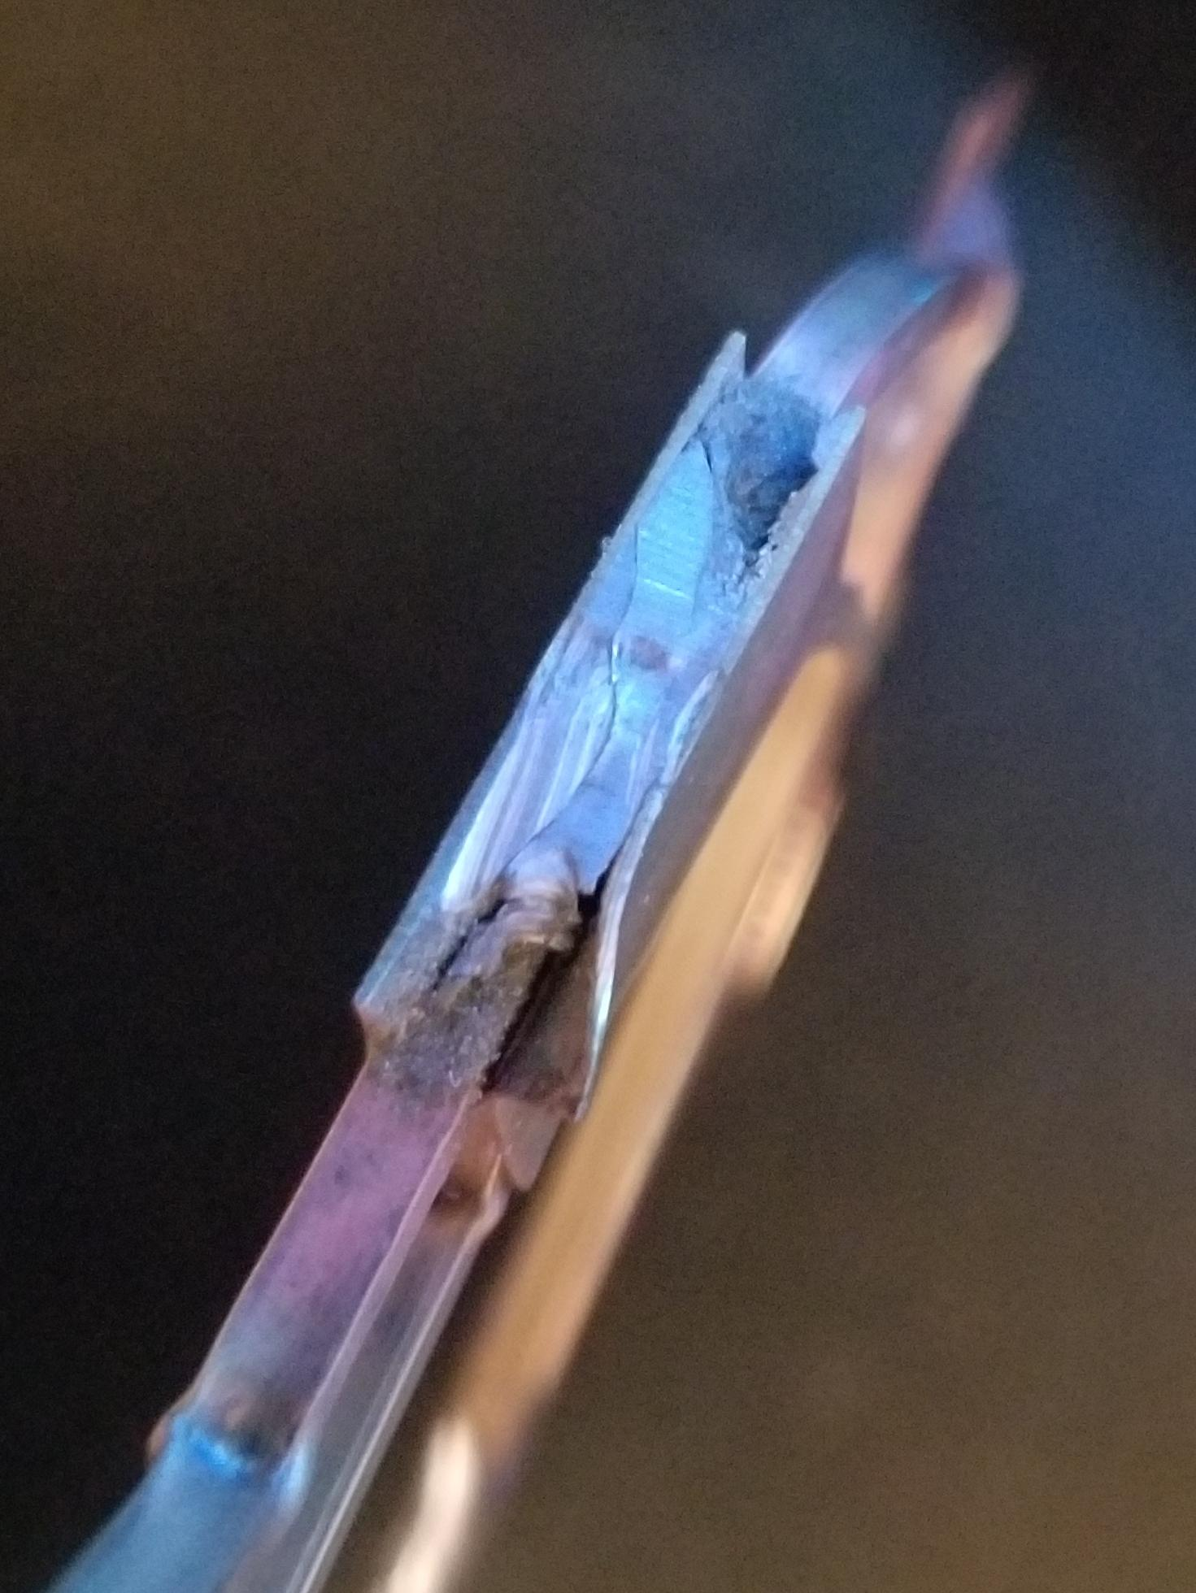
Why did the Truss Fail Early?
Members not meeting at same point
Excess solder on top of truss
Double Gusseting

Slide 14
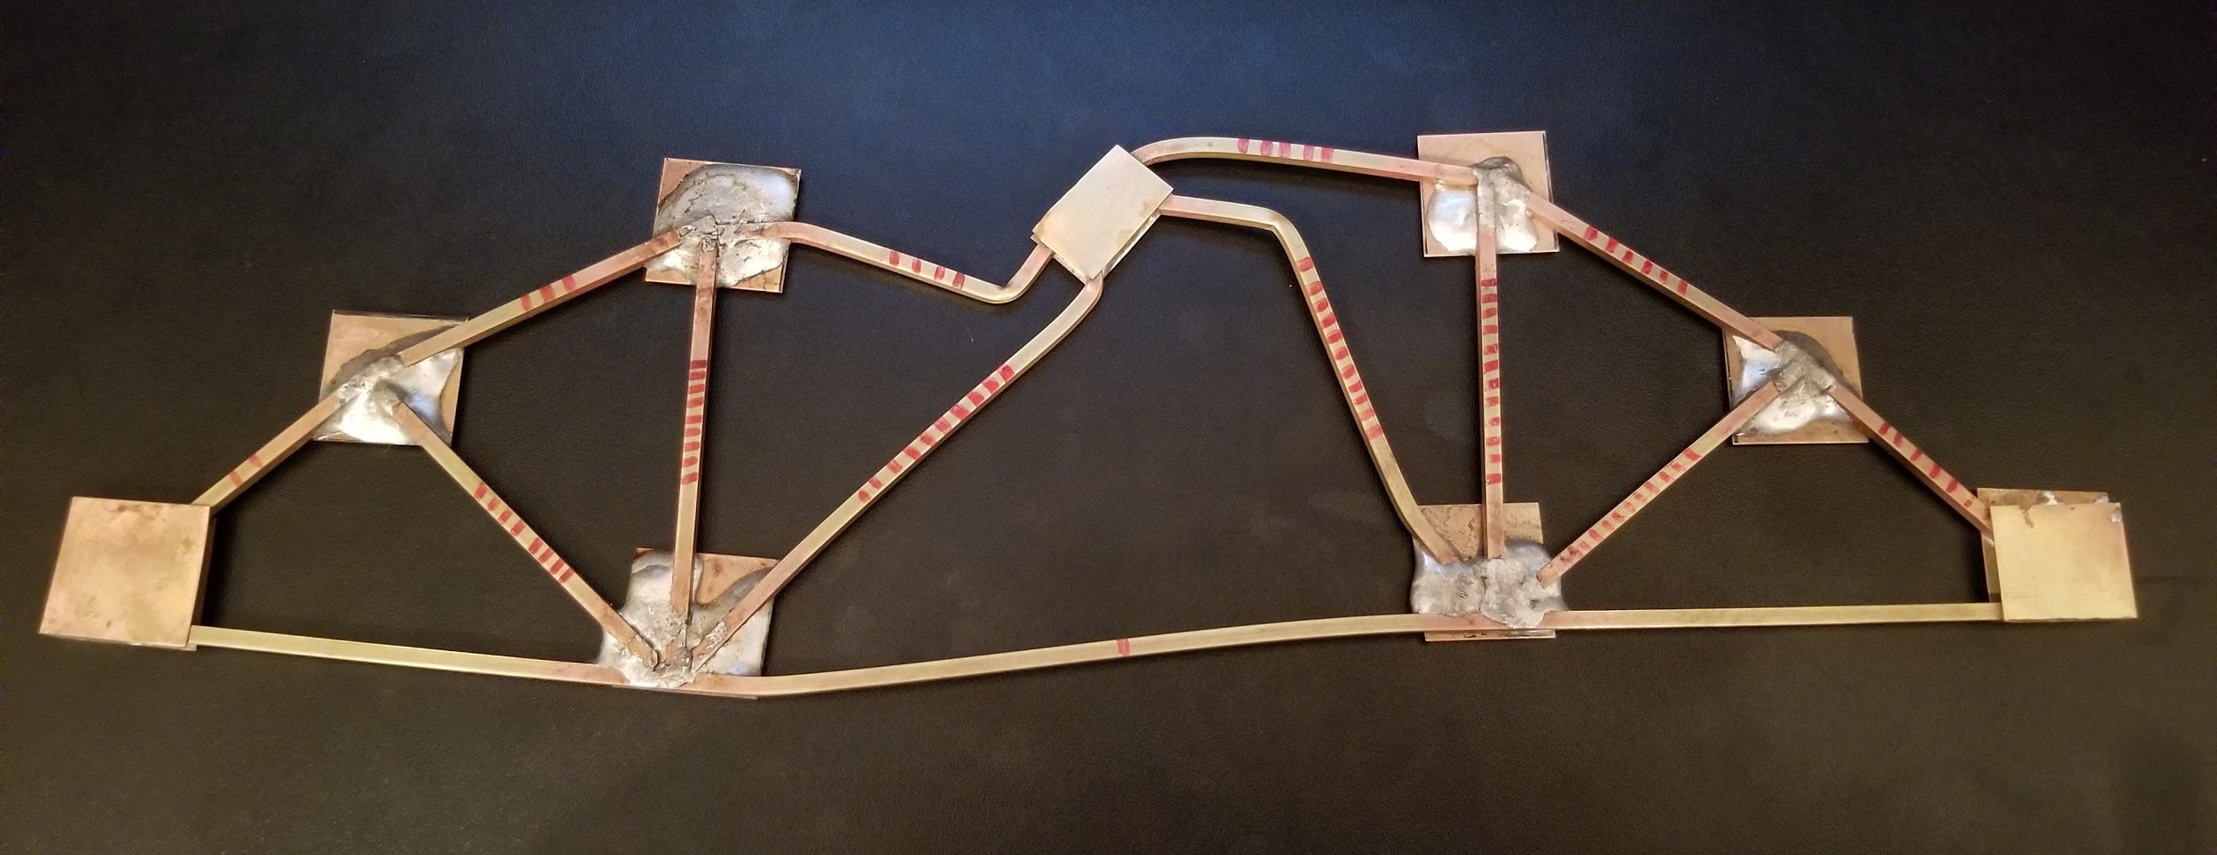
Which member failed?

Slide 15
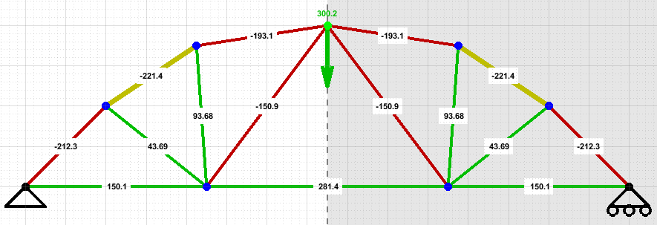
Which member failed?
Critical Buckling for Member 4: 325 lbs
Critical Buckling for Member 11: 135.8 lbs

Slide 16
Improvements:
Build 2 Trusses

